Slide 1
Team Basic Final Presentation
By Gabriel Hearne, Logan Barger, Elijah Pettit, George Paredes

Slide 2
Project Overview
Features implemented: 3/3
Milestones completed: 3/3
Initial LoC: 6906
Final LoC: 8207

Slide 3
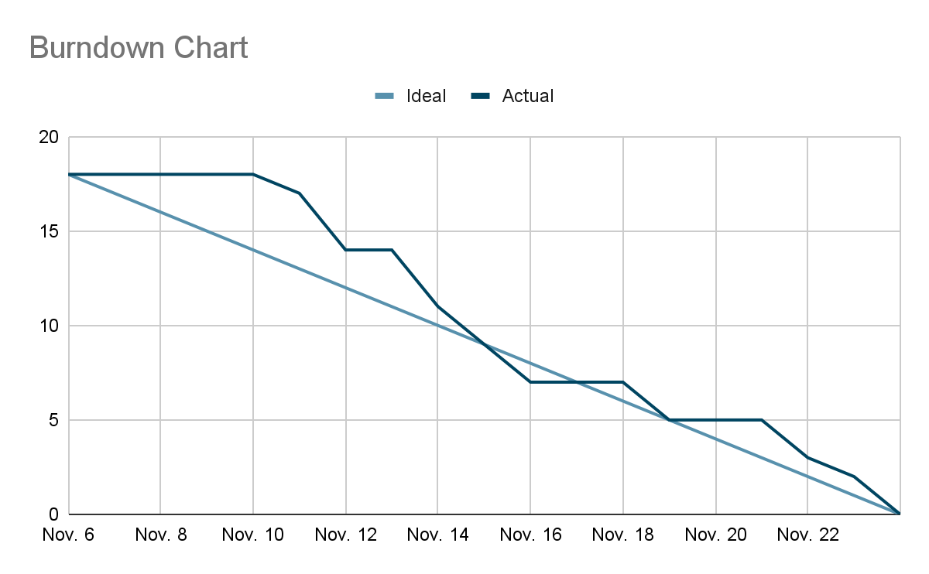
Burndown Chart

Slide 4
Feature 1 Upload and Download File
Successfully implemented feature
Added new page to upload, store, and download files
Added ability to delete files
Added table to store files
Unit test coverage: 83%

Slide 5
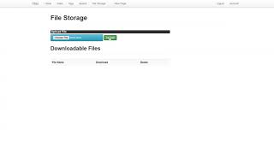
Feature 1 Demonstration

Slide 6
Feature 2: Download Wiki Pages
Successfully implemented feature
Added ability to download already created wiki pages
User can download files as md, docx, pdf,
User gets to see download information before downloading
Unit test coverage 100%

Slide 7
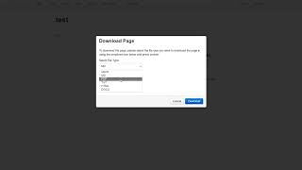
Feature 2 Demonstration

Slide 8
Feature 3: User Registration
Successfully implemented feature
Added create new account
Added ability to view profile
Added ability to delete account
Unit test coverage 100%

Slide 9
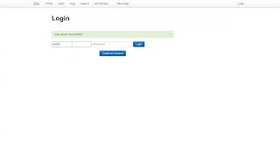
Feature 3 Demonstration

Slide 10
Testing Summary
7/7 Acceptance Tests
6/6 Integration Tests
27/27 Regression Tests

Slide 11
Lessons Learned
Start early, finish early
Ask questions more often
Take a break when you get stuck
Design is more important than coding

